Slide 1

Intro into Genome Assembly
Dikeledi Kekana
Centre for Respiratory Diseases and Meningitis,
National Institute for Communicable Diseases,
A division of the National Health Laboratory Service

Slide 2

Genome assembly
How to go from this…
To this…
To this…

Slide 3
General bioinformatics workflow: from fastq to fasta
Raw sequencing data
(fastq)
Input
QC stats
Adapter removal
Removal of low quality reads,
Primers, and artefacts
Quality control (QC)
Process + tools
Alignment to reference
- Consensus generation
De novo
Assembly
Output
Assembled sequence
(fasta)
Downstream
Analysis
Mutational analysis
Phylogeny
Annotation
Gene prediction and functional annotation
Used to address public health questions
…and many more

Slide 4
Pipelines and workflows for genome assembly
A pipeline/workflow will combine the above steps
Various publicly available workflows
Things to consider:
Sequencing platform used
Skill level and computational infrastructure
Web-based: easy to use, drag and drop, analysis happens on their servers so you don’t have to worry about compute power
Command line based: require familiarity with CLI, may require a high performance computing cluster (some do not), faster, allow you to modify parameters
Selection in each lab will be based on the above considerations

Slide 5
Things to consider: type of sequencing data
Read lengths
Long reads: resolving repeats and structural changes
Short reads: usually more accurate, helpful for calling variants and filling in gaps
Different assemblers are better for one/the other/a combination
Sequencing technology: each technology has its own pros and cons
Important to know the expected types of errors
Sanger, Illumina, Ion Torrent, Nanopore, PacBIO,…

Slide 6
Things to consider: type of sequencing data
Illumina short-read data: typically 150 bp per read
Sequencing by synthesis: measure fluorescence when nt added
High accuracy (error rate increases at end of read)
Susceptible to PCR errors and phasing (one strand out of sync in cluster)
Single-end reads: reads DNA fragment in one direction only
Paired-end reads: reads DNA fragment in two directions
Helps resolve structural changes, repeats, etc.
R1
R1
Know the length of the reads, plus the distance between them
R2

Slide 7
Illumina short-read data
Paired-end data helps resolve confusing areas. E.g. if R1 from single read maps to multiple regions, how do you know which is correct?
Here, R2 maps uniquely, so can use it to work out where R1 belongs
More info: https://emea.illumina.com/science/technology/next-generation-sequencing/plan-experiments/paired-end-vs-single-read.html

Slide 8
Things to consider: type of sequencing data
Ion Torrent: Read lengths of ~200 – 600bp (varies in a batch)
Technology: measure changes in pH to call nucleotide
Susceptible to mis-calling insertions/deletions → frameshifts
Nanopore: read length varies, can be a few million bp
Normally 10s of thousands
Technology: pass nucleic acid through pore and measure change in current to call base
Early tech had 65 – 88% accuracy, now 85 – 95%
Susceptible to mis-calling the length of homopolymers (stretches of same nt)

Slide 9
Things to consider: type of sequencing data
Sometimes paired-end reads can’t resolve a repeat region, especially if the repeat length > read length
This is where long reads are especially useful as they can sequence through the repeat

Slide 10
Things to consider
Is it a known genome or a novel pathogen?
Is there a reference you can use?
Is there a significant genome feature you should be aware of?
What computer power/infrastructure do you have?
Command-line experience vs websites and applications

Slide 11
1. Is it a known genome?
Yes! SARS-CoV-2 has been sequenced many times across the world
Lots of information at https://www.ncbi.nlm.nih.gov/sars-cov-2/
Provides valuable information on different wet lab and bioinformatic methodologies
Can try different approaches
Can often reach out to authors
Sometimes custom software available

Slide 12
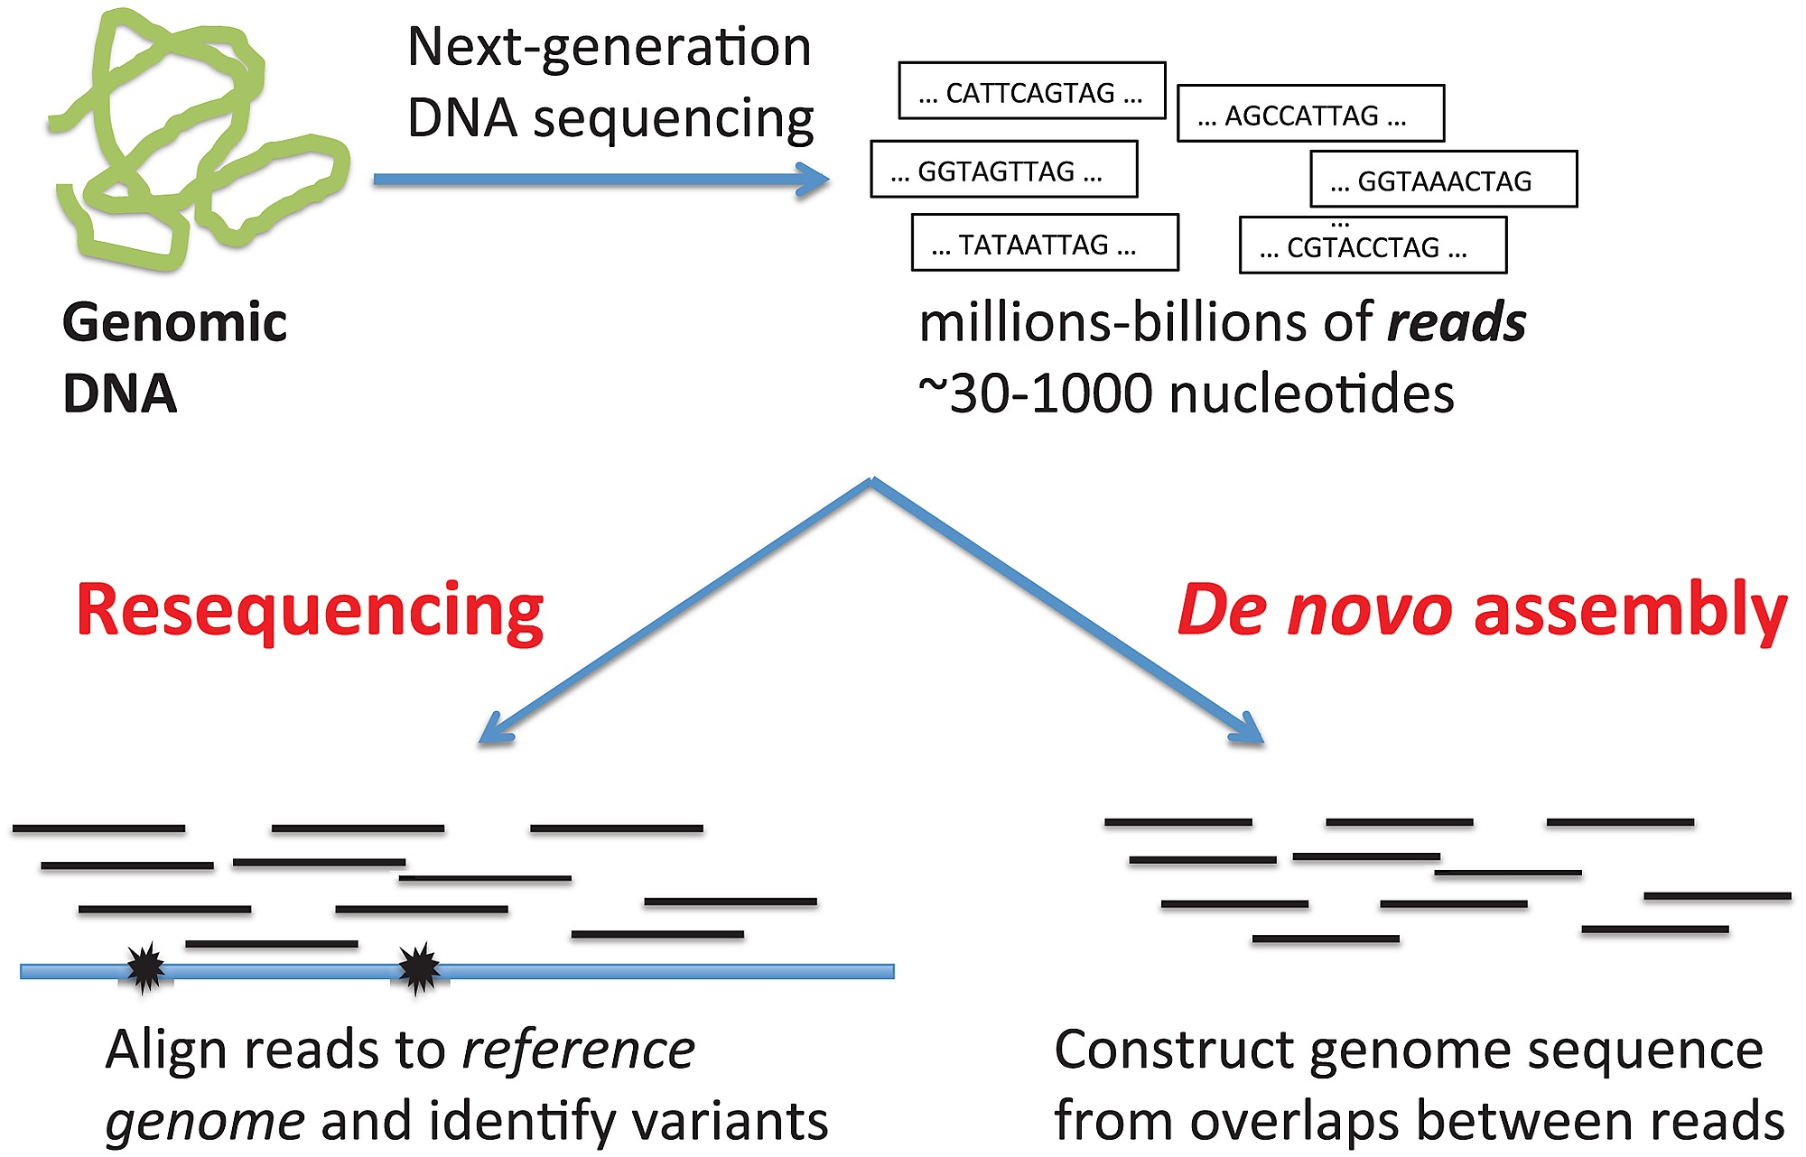
Adapted from Raphael et. al. 2015

Slide 13
2. Is there a reference sequence available?
Yes!
NCBI RefSeq: well-annotated genomes from GenBank
Each sequence has a unique identified
NC_045512
Complete genome
https://www.ncbi.nlm.nih.gov/nuccore/NC_045512.2?report=fasta
GISAID also has its own reference sequence

Slide 14
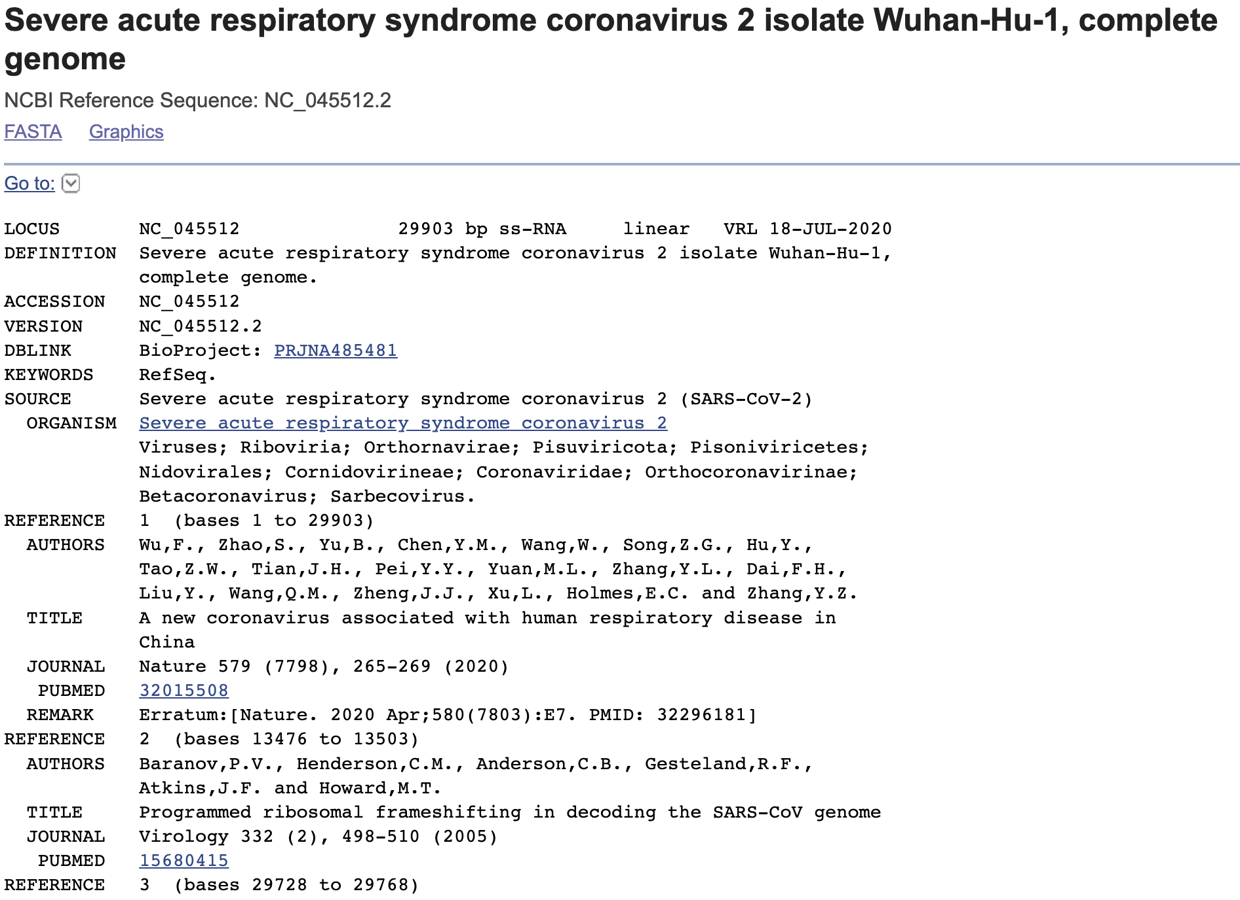
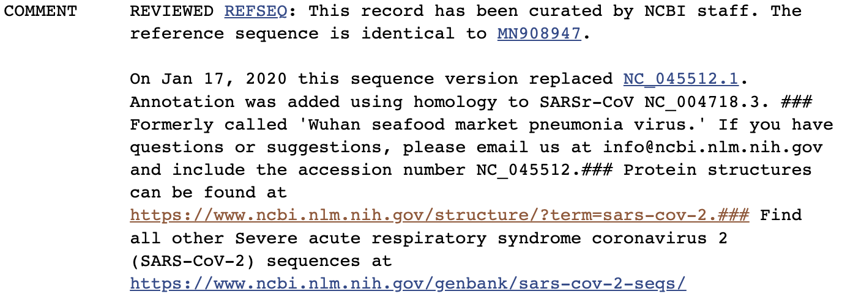
2. Is there a reference sequence available?
Basic information about the entry: accession number, length, type of nucleic acid
Taxonomic information
Literature sources
Notes on curation. Gold standard is manually curated complete, annotated genome

Slide 15
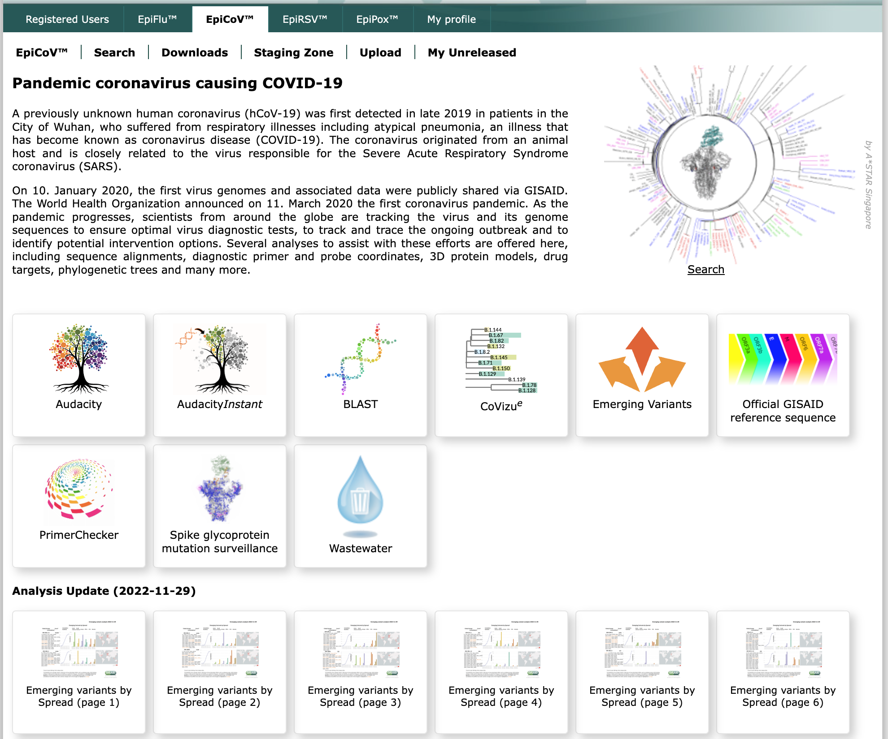
2. Is there a reference sequence available?
There is a standard, commonly-used, high-quality, annotated genomes available on NCBI’s nucleotide database
GISAID also has its own reference (and provides literature evidence)

Slide 16
3. Is there a significant genome feature you should be aware of?
No big structural changes yet
Some deletions
Possibly acquiring a large deletion in ORF7b
If there are any, can be used for QC

Slide 17
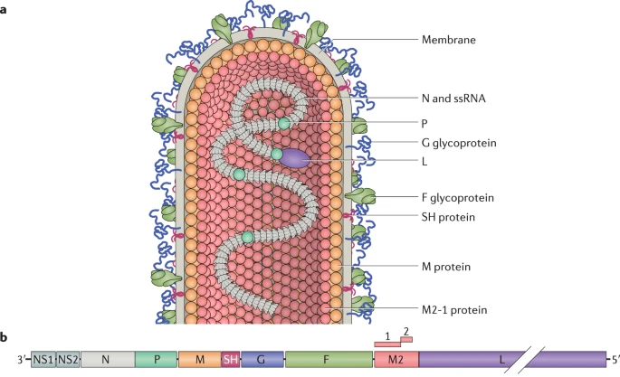
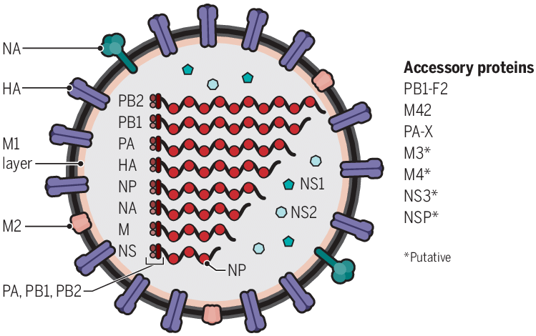
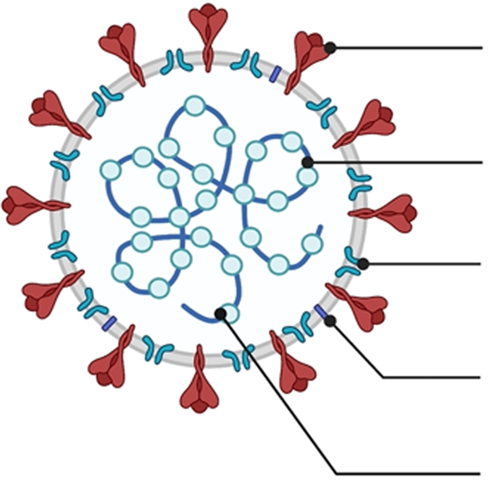
RSV FLU SARS-CoV-2
S
N
M
E
https://www.nature.com/articles/s41579-019-0149-x
https://www.science.org/doi/10.1126/scitranslmed.aau5485
https://www.nature.com/articles/s41431-022-01108-8
ssRNA
Flu
~13 500 nt
Focus in all three: surface glycoproteins
Targets for drugs and vaccines
RSV
~15 200 nt
SARS-CoV-2
~29 900 nt

Slide 18
4. Compute power/infrastructure 5. Command line vs user interface
Different tools require different levels of experience with the command line and different computing power
Benefit of web-based applications: often user-friendly, analysis happens on their servers so you don’t have to worry about compute power
Consider privacy and security of uploading genomic data
Benefit of CLI tools: often more flexible
I can run the assembly tool of viral-ngs on my laptop (16GB RAM, 8 cores) but for large batches and parallel processing we require a server

Slide 19
Some basic terminology
Fastq file: file from sequencing machine containing
sequence data
quality information
identifiers and location information (where on flowcell the sequence was)
@sequence name: (options location information)
ATCGCGCTAGAGGGAAATCTCCTAAA
+
AAAA::*99@85478BB::?? For bioinformatic tools (quality info)
Fasta file: file containing sequence name and sequence
>sequence name
ATCGCGCTAGAGGGAAATCTCCTAAA

Slide 20
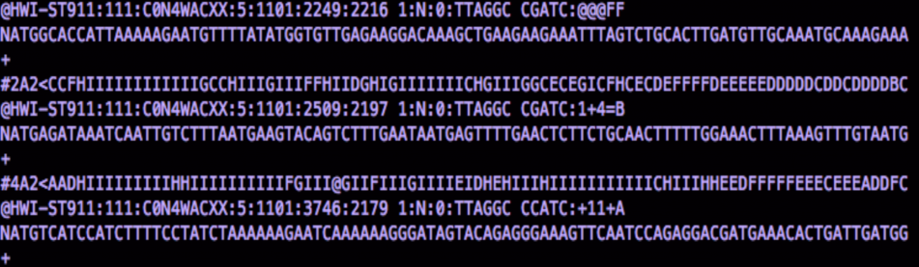
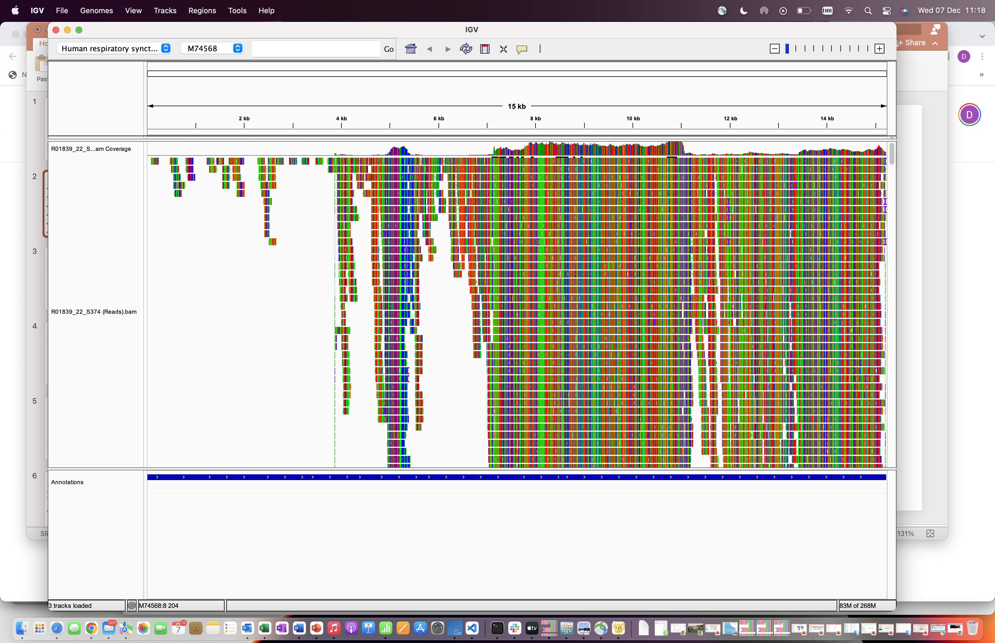
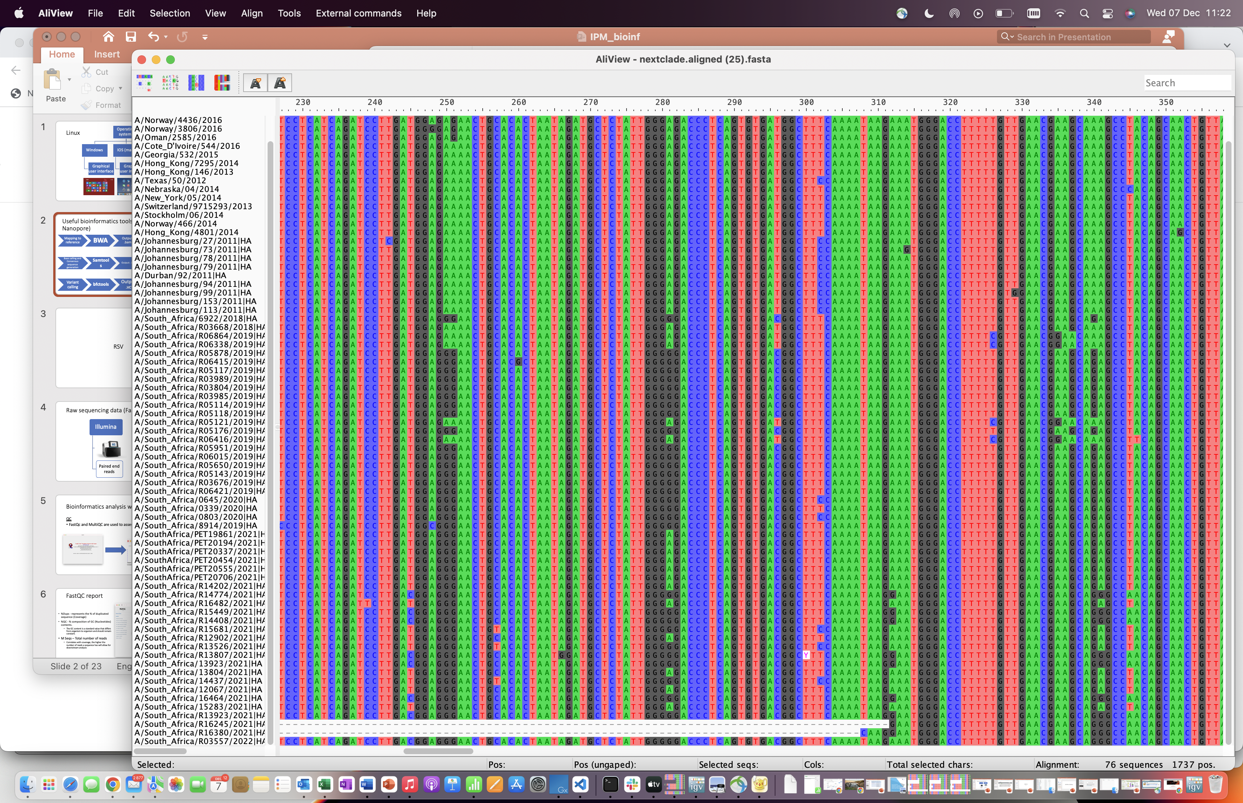
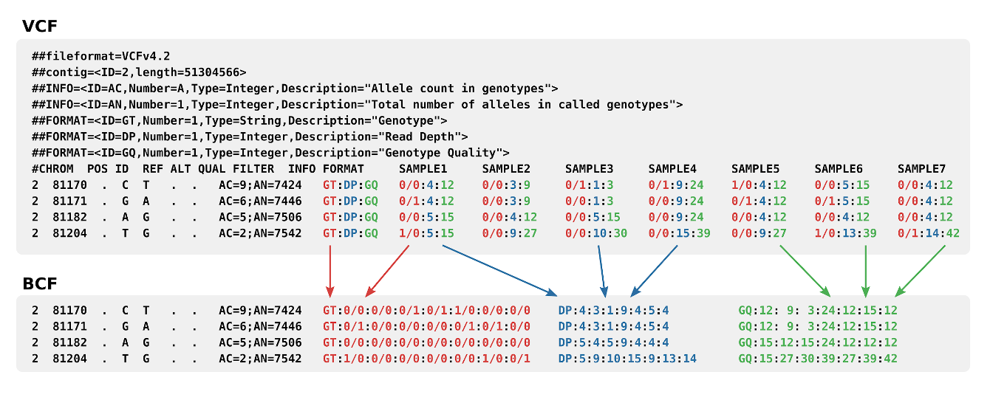
Different file formats
Raw reads
Output: .fastq.gz
Mapping to reference
Output: .bam
Base calling and Consensus sequence generation
Output: .fasta
Variant calling
Output: .vcf

Slide 21
Read length: how long a sequence fragment from the sequencing machine is
Depth: how many times a single base has been sequenced
Coverage: how much of the reference genome is covered by your sequencing data
Note: depth and coverage are sometimes used interchangeably
Total reads: number of reads produced per sample
Mapped reads: number of reads that aligned to your reference genome (always ≤ total reads)

Slide 22
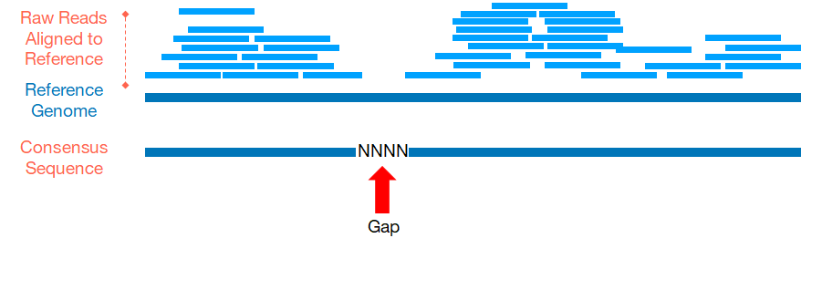
Quality control - assembly
Depth
%Ns
Genome coverage

